Slide 1
CZ
Client: Kylie Huard at the Dunedin City Council

Slide 2
Value Proposition
This project is helping to address the issue of road cyclists safety with how vehicles are passing them. It has been in use since August 2015. During this time is has been recording vehicle passing speeds and distances showing the most problem areas where dangerous incidents have been occurring. It has shown that 35% of vehicles are passing cyclists dangerously.

Slide 3
Functional requirements
The system must record how close cars are passing cyclists
The system must record where close passes have happened
The system must record when the close pass happened
The system must record data in a readable format
The system must have a way of getting the data to a meaningful place

Slide 4
Interaction Design
Try to keep interaction between user and system minimized

Slide 5
System/software architecture
Hardware
Arduino
Sonar sensor
SD card reader
Bluetooth
Software
Mobile interface
Interface for DCC

Slide 6
Hardware
Sonar sensor – HC-SR04
SD card writer/reader- Micro-SD Breakout board+
Bluetooth module – nRF0001 Bluetooth LE

Slide 7
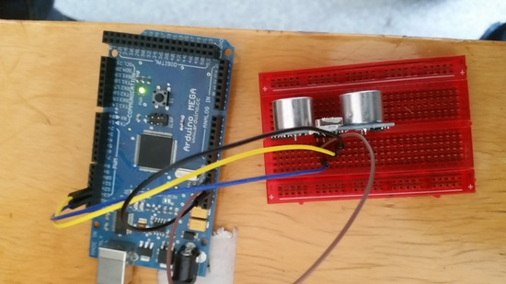
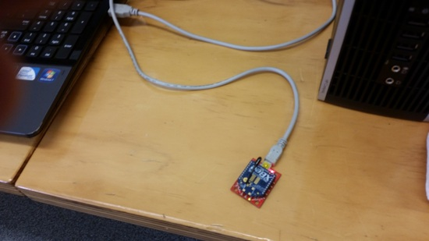
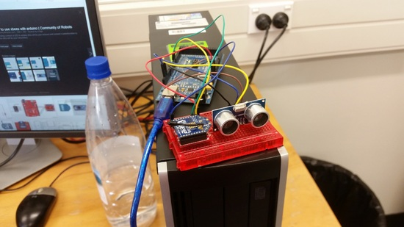
Stable Platform
We are currently using a HC-SR04 sonar sensor
Proof of concept of wireless transmission using xbees

Slide 8
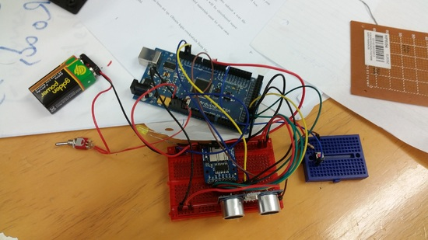
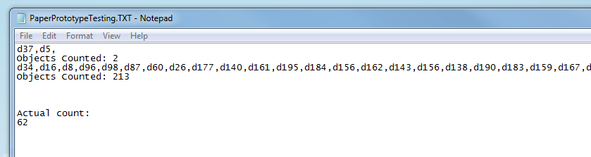
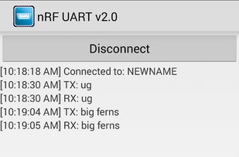
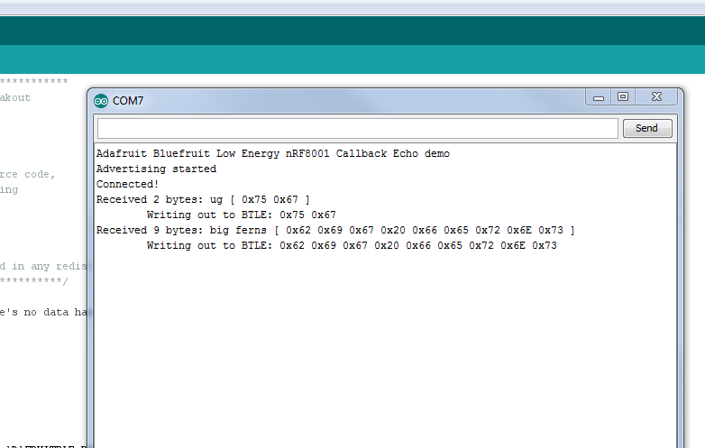
Stable Platform
We have data writing to SD card
Arduino communicating with android phone via bluetooth

Slide 9
MVP
To get our current system mobile and recording real world data
Portable

